Slide 1
Medical Debt in Maine
January 25, 2024

Slide 2
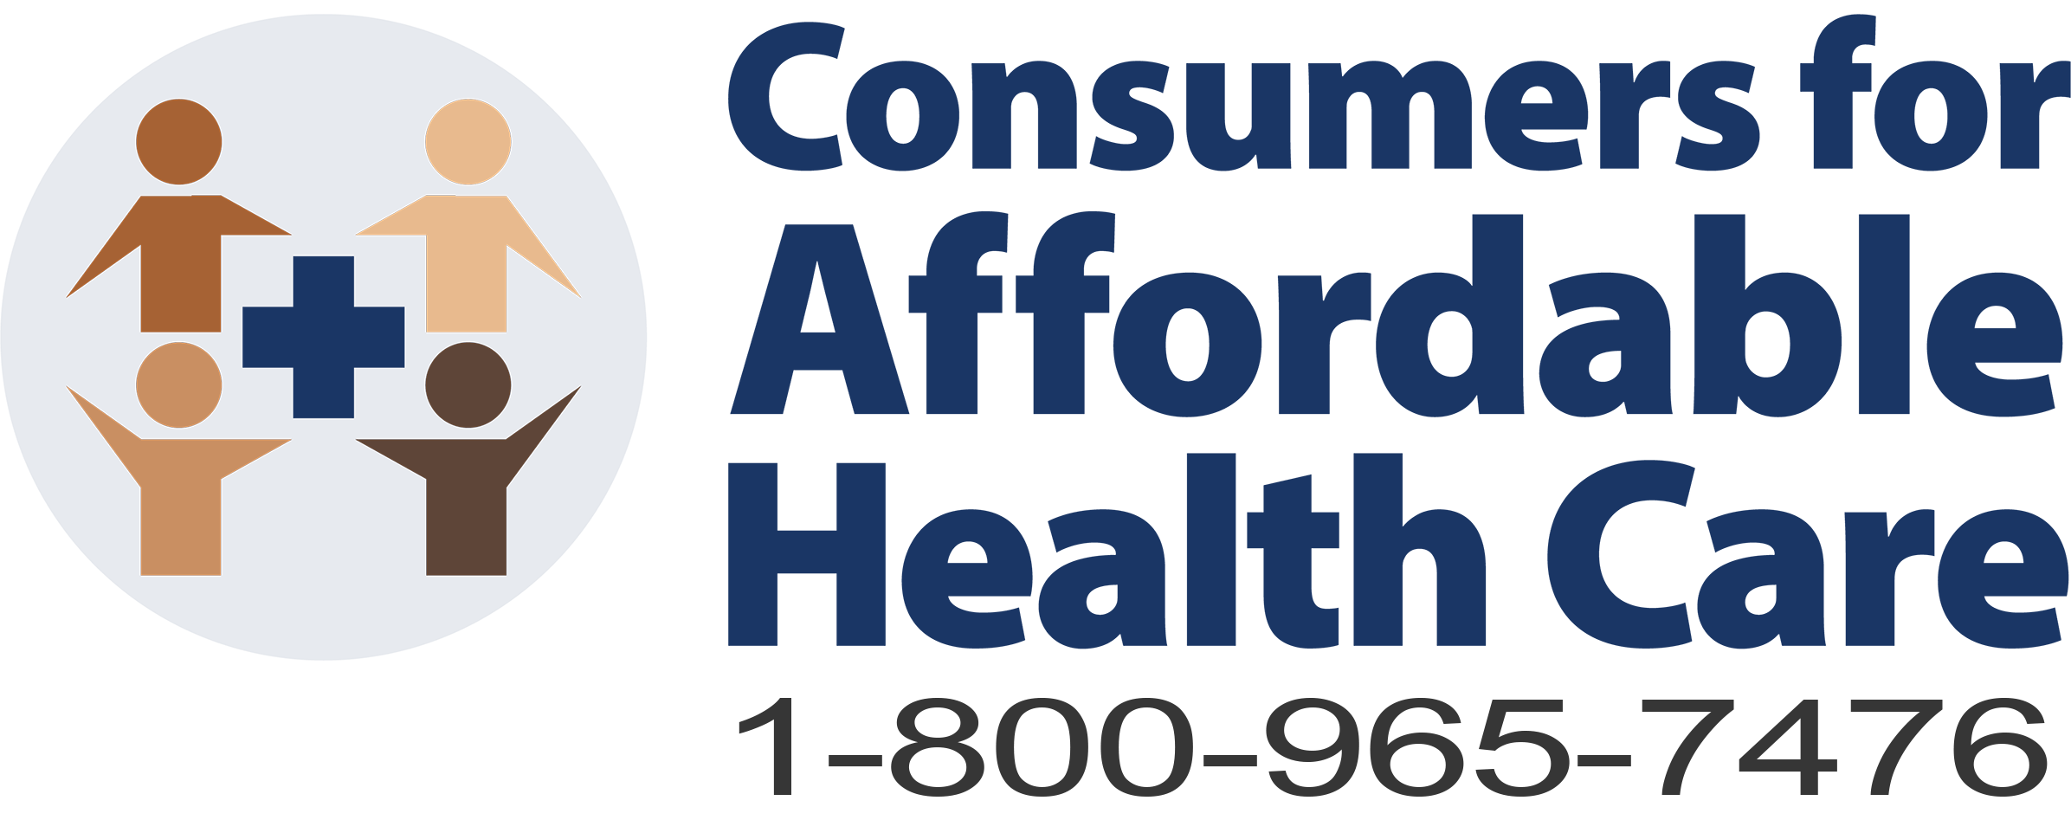
Maine’s Consumers Assistance Program
Toll Free HelpLine and in-person assistance available
Marketplace enrollment assistance (CoverME.gov)
MaineCare enrollment assistance
Insurance appeals and denials assistance
Workshops and trainings
Application assistance and referrals to safety net programs including hospital free care, prescription assistance programs and sliding fee clinics

Slide 3
Consumer Assistance Program 2023 highlights
7,256 calls fielded with Mainers on toll-free Helpline - nearly a 25% increase in calls over 2022
Half of calls related to keeping, renewing or getting coverage
25% were related to coverage issues including network issues and coverage denials
198 calls about Hospital Free Care, assisted 42 consumers with applications, and a Free Care explanation sheet was downloaded 1,881 times from CAHC’s website.
Affordability was reported as a barrier in 21% of calls, a significant increase over 2022 (2.75%)

Slide 4
Medical Debt in Maine
Examining Views Towards Health Care in Maine
Survey Conducted on Behalf of Maine Consumers for Affordable Health Care
by:

Slide 5
Almost half of Maine households have medical debt.
Prevalence and Persistence of Medical Debt
Almost all of those who took on medical debt within the past two years still have debt (92%).
In the past two years, have you or anyone in your immediate family taken on debt or received bills you couldn’t pay from a medical health care service, procedure, tests, medical device, or prescription drugs? / Do you currently have any medical debt?
(n=500)

Slide 6
Three out of four Mainers with medical debt say diagnostics contributed to their debt. More than half say emergency room treatment contributed to their debt. Four out of ten say urgent care, dental care, surgery, or prescription drugs contributed to their debt.
Contributors to Medical Debt
(% who say service type has contributed to debt)
Among those who have had medical debt themselves or who have a family member with medical debt in the past 2 years (n=233)
Did any of the following contribute to your/your family member’s medical debt?

Slide 7
Six out of ten Maine families experienced at least one of the impacts below as a result of medical bills. Many struggled to pay for necessities, used savings, incurred credit card debt, or were contacted by a collection agency, most often due to a bill from a hospital.
Financial Impacts of Medical Expenses
(% who have experienced impacts)
Experienced as a Result of Hospital Bill
(% among those who experienced impact)
72%
71%
61%
83%
57%
76%
54%
56%
78%
49%
37%
62% of Maine families have experienced at least one of these impacts.
On average, Maine families have experienced almost three of these impacts.
(n=500)
Base depends on the number of participants who experienced impact.
In the last two years, have you or any member of your immediate family experienced the following as a result of any medical expenses? / Did you or any member of your immediate family experience the following as a result of a hospital bill, specifically?

Slide 8
Many Mainers have delayed or skipped medical care due to high health care costs. More than 6 out of ten Mainers have taken at least one of the actions below in the past two years due to costs.
Actions Taken Due to Medical Costs
(% who taken actions due to concerns about costs)
A total of 63% of surveyed Mainers have taken at least one of these actions.
On average, Mainers took almost three of these actions in the past two years due to cost concerns.
One out of four consumers have taken one or both of these actions related to prescription drugs (24%).
(n=500)
In the past two years, have you done any of the following due to concerns about costs?

Slide 9
Only one out of ten Maine families with hospital-based medical debt receive financial assistance through a hospital. Twice as many have been denied financial assistance through a hospital.
Financial Assistance Through Hospitals
Roughly half of Mainers who have hospital-related medical debt are not aware that hospitals in Maine are required to provide medically-necessary care for free to Mainers who meet certain income guidelines (47%).
Among those who acquired medical debt or have a family member who acquired medical debt through a hospital in the past two years (n=178)
In order to help pay for the hospital bills that contributed to your/your family member’s medical debt, did you/they apply for financial assistance through the hospital? / Were you/they approved for free or sliding-scale care through the hospital? (Those who were unable to answer the question are assumed not to have applied for or received assistance.)

Slide 10
Strong majorities of Mainers support a variety of proposals that directly reduce the costs of health care. Nine out of ten support enforcing price transparency rules or limiting hospital charges. Three out of four support requiring hospitals to increase the amount of financial assistance they must provide.
Support for Proposals to Improve Transparency or Reduce Hospital Costs
The full descriptions of the policy proposals shown to participants are listed on page 40.
(n=500)
To what extent would you support or oppose the following policies that would be designed to improve access to health care or address prescription drug and health care costs?

Slide 11
Demographic Characteristics of Survey Respondents
Gender
Male | 48%
Female | 51%
Some other way | 1%
Race/Ethnicity
White or Caucasian | 96%
Native American | 2%
Hispanic or Latino | 2%
African American | 1%
Asian or Pacific Islander | 1%
Middle Eastern | <0.5%
Some other race, ethnicity | <0.5%
Prefer not to say | 1%
Age
18 to 24 | 7%
25 to 34 | 16%
35 to 44 | 20%
45 to 54 | 18%
55 to 64 | 21%
65 to 74 | 13%
75 and older | 4%
AVERAGE | 48
Marital Status
Married | 45%
Single, never married | 24%
Living with partner | 12%
Divorced/separated | 14%
Widowed | 4%
Prefer not to say | 1%
Congressional District
CD1 | 50%
CD2 | 50%
(n=500)

Slide 12
Demographic Characteristics of Survey Respondents
Education
High school graduate or less | 38%
Some college, technical school | 31%
College, tech. school graduate | 22%
Graduate school | 8%
Prefer not to say | 1%
Employment Status
Employed full-time | 41%
Employed part-time | 9%
Not employed, looking for work | 6%
Retired | 17%
Student | 2%
Stay-at-home parent / caregiver | 7%
Something else | 5%
Unable to work due to medical, health, or other issues | 13%
Household Income
Less than $25,000 | 25%
$25,000 - $49,999 | 25%
$50,000 - $74,999 | 20%
$75,000 - $99,999 | 13%
$100,000 - $149,999 | 9%
$150,000 - $199,999 | 2%
$200,000 - $249,999 | 1%
$250,000 or more | 1%
AVERAGE | $61k
Prefer not to say | 4%
Number of Adults Covered by Health Insurance Policy*
0 | --
1 | 47%
2 | 36%
3 | 10%
4+ | 4%
Not sure | 3%
Number of Children Covered by Health Insurance Policy*
0 | 71%
1 | 13%
2 | 7%
3 | 4%
4+ | 2%
Not sure | 3%
(n=500)
* Among those who have health insurance (n=461)

Slide 13
Ann Woloson, Executive Director awoloson@mainecahc.org
www.mainecahc.org

